Slide 1
Halstead’s Software Science

Slide 2
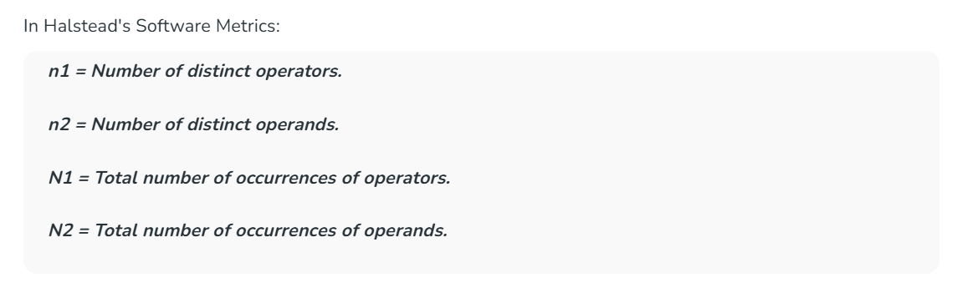
Halstead’s Software Science
Halstead’s complexity measurement was developed to measure a program module’s complexity
directly from source code, with emphasis on computational complexity. The Halstead’s measures are based on four scalar number derived directly from a program’s source code:

Slide 3
Program length (N):
This is the total number of operator and operand occurrences in the program.

Slide 4
Halstead Vocabulary
The total number of unique operators and unique operand occurrences.

Slide 5
Program Volume
Proportional to program size, represents the size, in bits, of space necessary for storing the program.

Slide 6
Program difficulty
This parameter shows how difficult to handle the program is.
D = (n1 / 2) * (N2 / n2)

Slide 7
Program Effort
Measures the amount of mental activity needed to translate the existing algorithm into implementation in the specified program language.
E = D * V = Difficulty * Volume

Slide 8
Guidelines for calculating operators and operands
1. All the variables and constants are considered as operands.
2. Local variables with same name, if occurring in different functions are counted as unique
operand.
3. Function calls are considered as operators.
4. The looping statements, do … while, while, for, are operators. The statements if, if …
else, are operators. The switch … case statements are considered as operators.
5. The reserve worlds, returns, default, continue, break, sizeof are all operators.
6. The brackets, commas, semicolons, are operators.
7. The unary and binary operators are considered as operators. The & is considered as
operator.
8. In arrays, array name and index are considered as operands and [ ] is considered as
operator.
9. All hash directives can be ignored.
10. Comments are not considered.
11. In Goto statement, goto is considered as operator and label as operand.

Slide 9
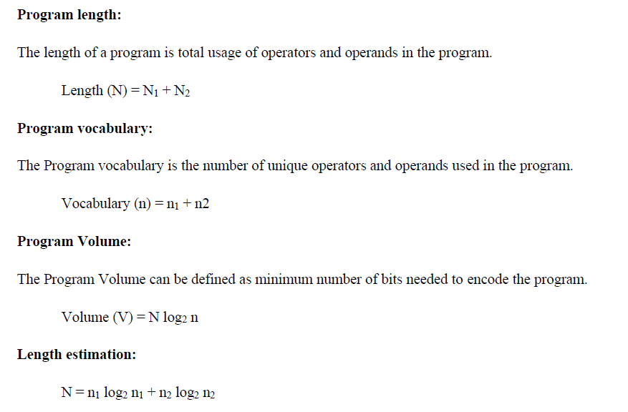

Slide 10
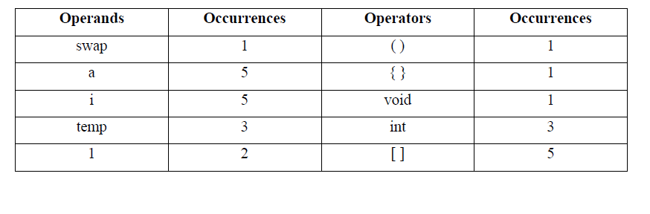
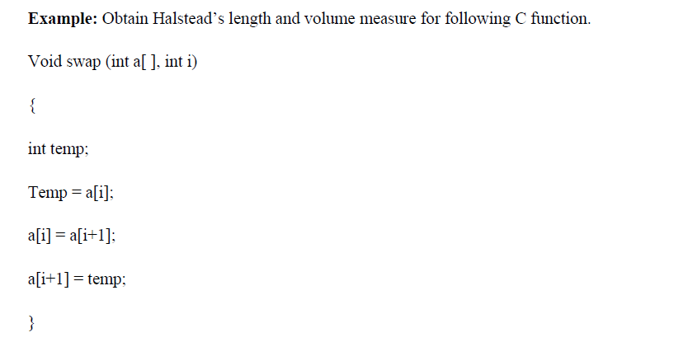
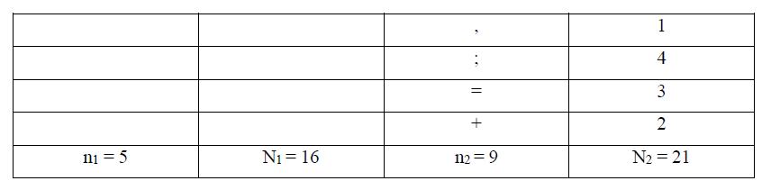
Example

Slide 11
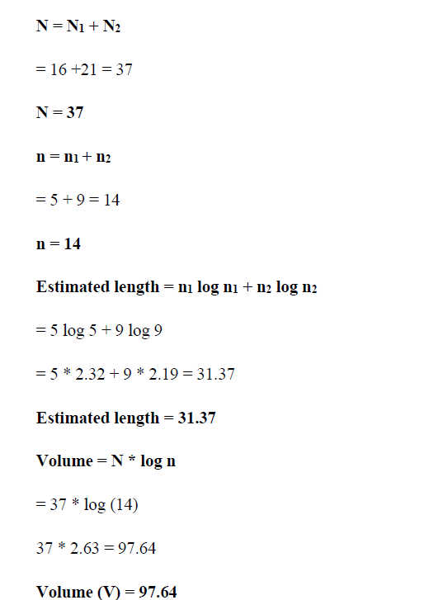

Slide 12
Example
Unique Operators
void → reserved word → operator
() → brackets → operator
{} → block braces → operator
; → semicolon → operator
sayHello → function call → operator
Unique Operators (n₁) = 5
Unique Operands
greet → method name in declaration → operand
Unique Operands (n₂) = 1
void greet() {
sayHello();
}

